Slide 1
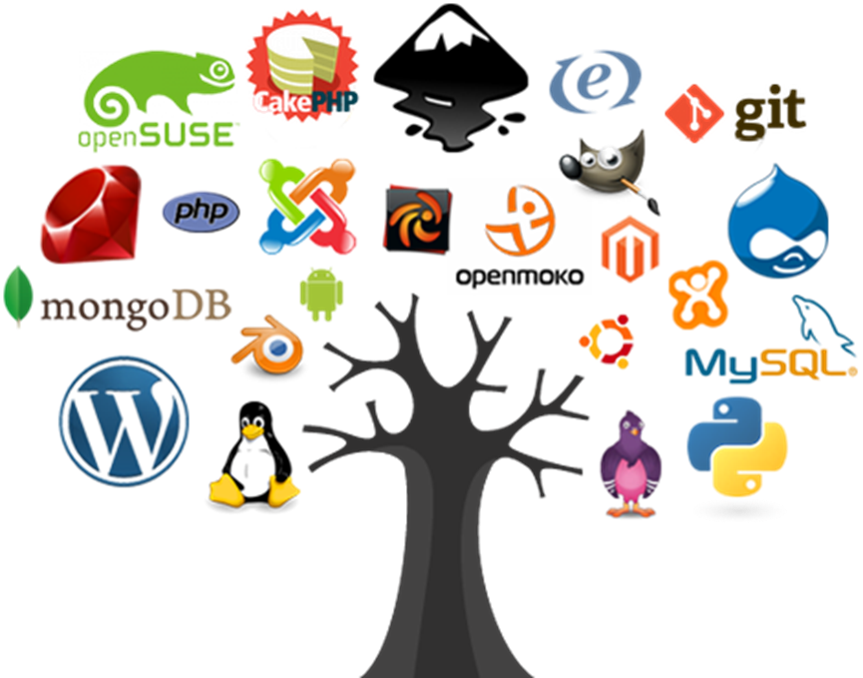
Using conda in the Open Source world
David C King
ONish computing workshop, Summer 2022

Slide 2
What does it offer?
free alternatives of commercial software
programming and scripting languages
free software to use languages
Open Source – code available to everyone
See how things work- improve upon ideas, find flaws

Slide 3
What does it offer? (2)
research – see how they did it
security – see if it's really secure (math)
can be a scientist, hobbyist, etc.
don't have to work Microsoft, Adobe

Slide 4
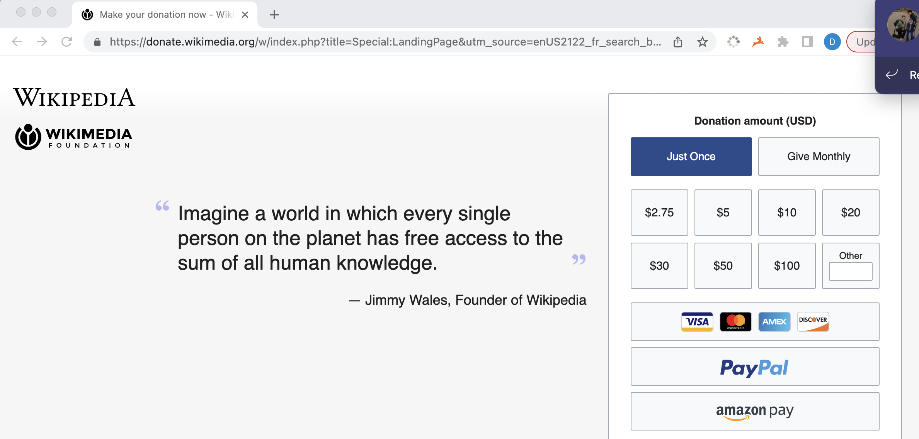
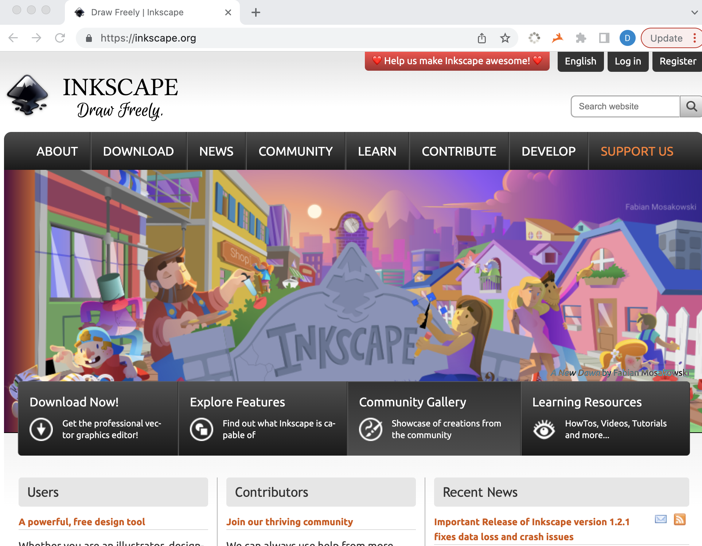
How is there money for this???

Slide 5
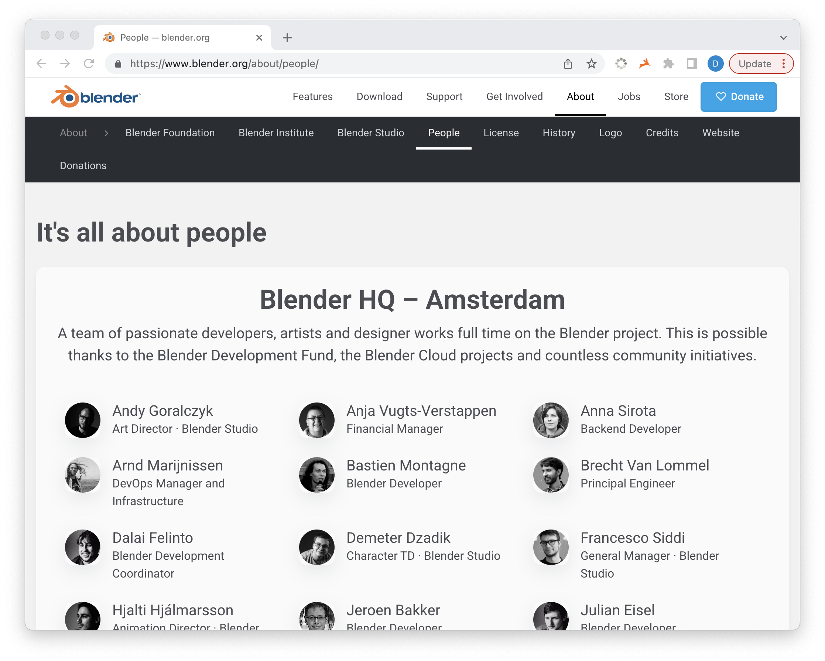
REALLY????

Slide 6
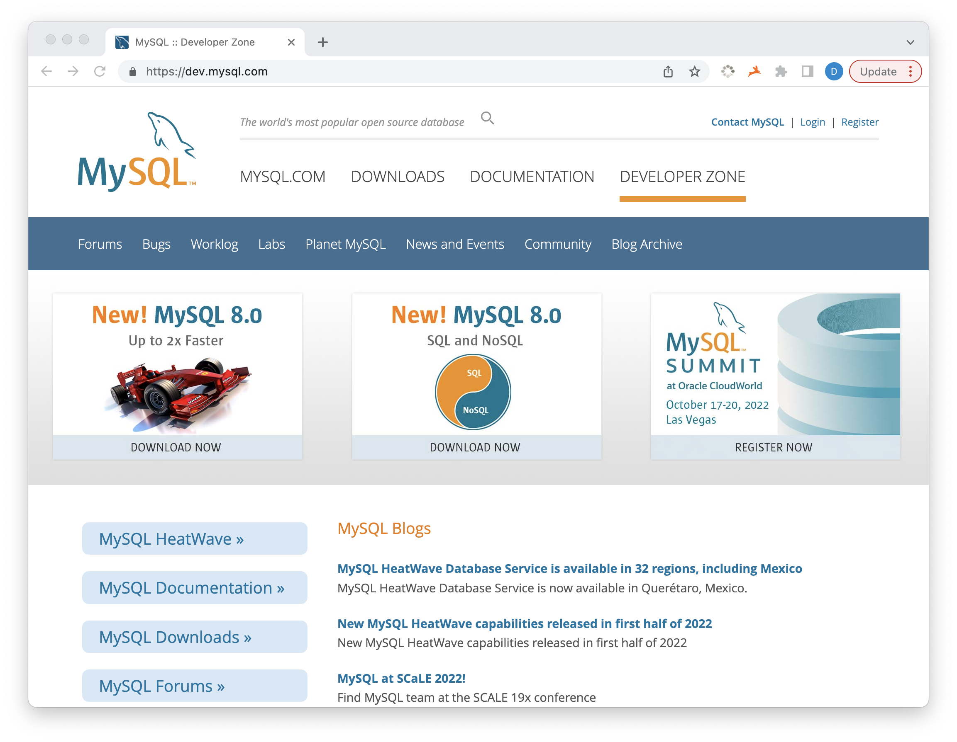
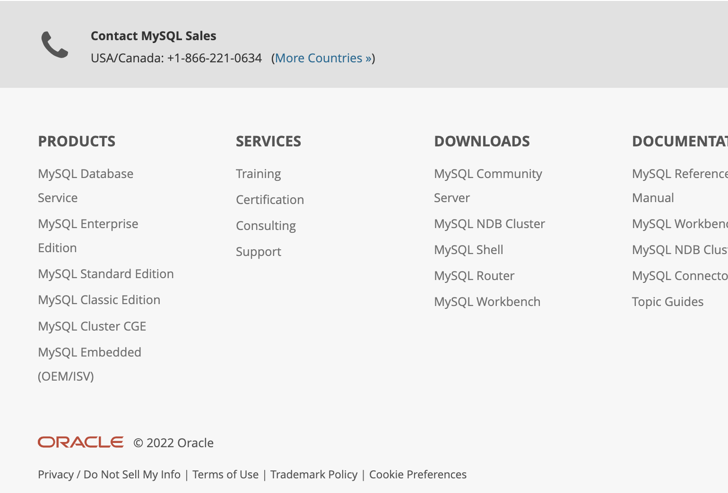
REALLY????

Slide 7
Open Source fed by Corporate Products
RStudio
mysql/java – Oracle
Github – Microsoft
Make money by offering support, upsells, servers, while fostering the open source

Slide 8
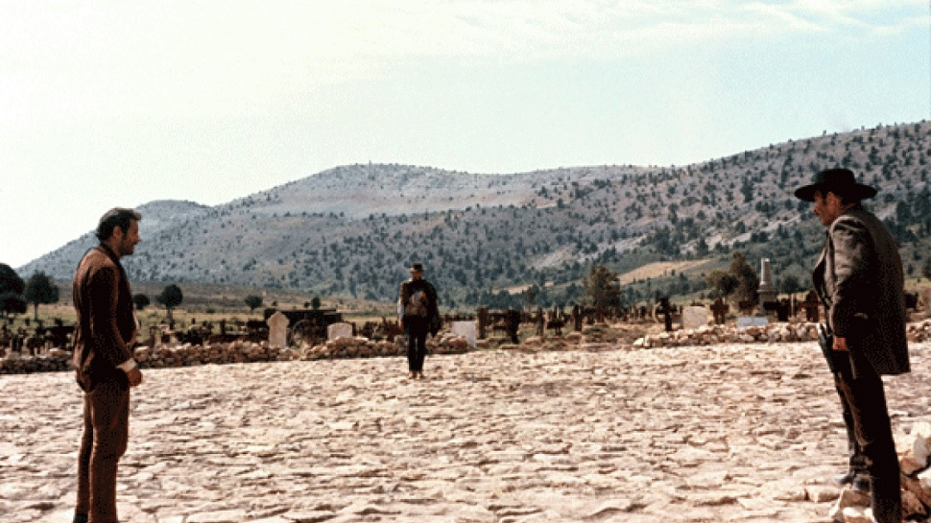

The Good,...
Free
Community-driven
Democratic
The Bad, ...
Only free if your time is worth nothing – Marc Nishimura
Setup is your problem
Higher barrier to entry for coders
The Ugly
Dependency HELL

Slide 9

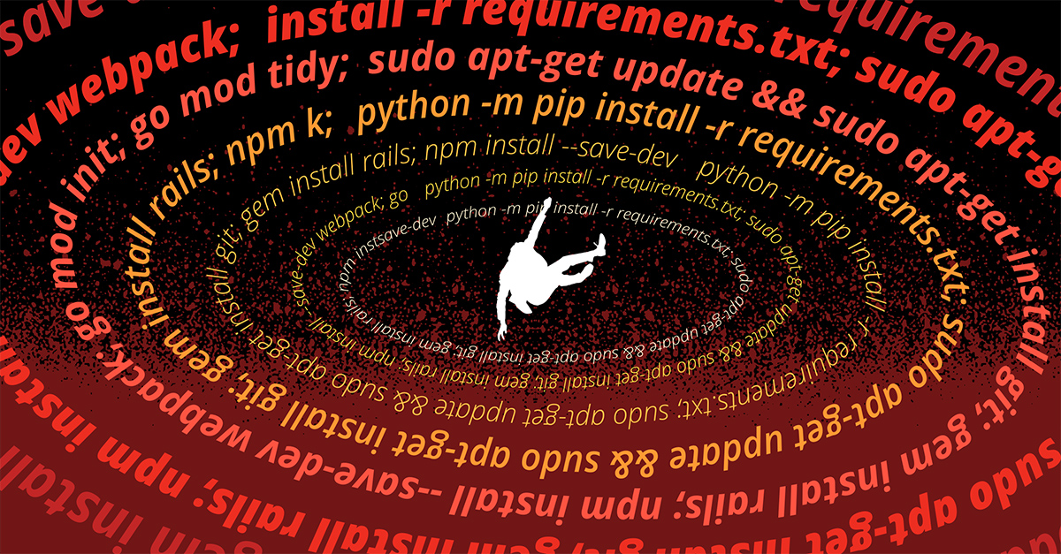
Dependency Hell
https://about.sourcegraph.com/blog/nine-circles-of-dependency-hell

Slide 10
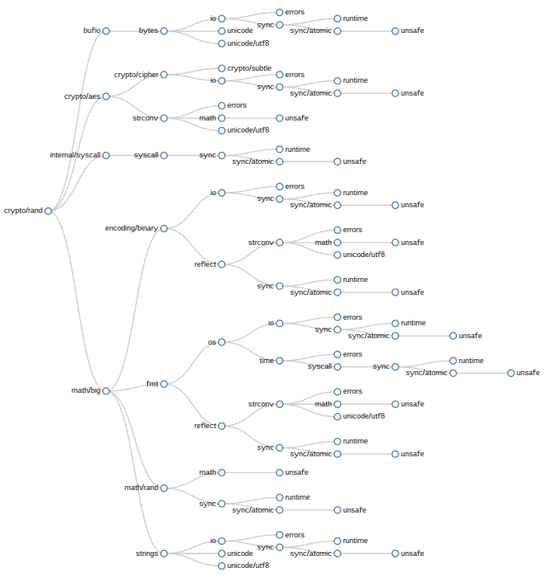
Dependency Graph
An application that uses cryptographic libraries, which use synchronization libraries, which use string manipulation libraries, etc.

Slide 11
Food pyramid of programming
scripting
User programming
Microsoft Excel
Other Office apps
Web browser
Installed Apps
R
PERL
Python
Julia
low-level programming
Shell: bash, zsh, etc.
Application Programming Interface (APIs)
c standard libraries:
call memory allocation
call file I/O
data types
c utilities:
math algorithms (sqrt, log, trig)
multithreading
gnu fortran:
LAPACK- linear algebra
...matrix algorithms
stats
open source utilities:
specialized requires installation
Operating System / Device Drivers
low level:
assembly
machine language
binary
direct communication with hardware:
disk I/O
network I/O
memory allocation
processor (CPU):
application management
multitasking:
concurrency
parallelism

Slide 12
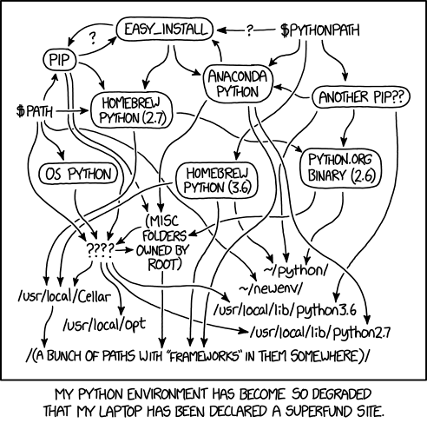
What is conda?
Replaces the python virtual environments
Have isolated environments that don’t conflict with each other
Automatically sets $PATH, $PYTHONPATH, $LD_LIBRARY_PATH for your environment
~From XKCD

Slide 13
How to get started with conda?
Command line: Mac, Linux, or Windows Linux Subsystem
Download and install miniconda for your shell: https://docs.conda.io/en/latest/miniconda.html
A base environment is created for your login shell
base – useful general command line utilities
tree: directory listing
dos2unix: convert Windows line endings to unix (\r to \n)
gzip/bzip2/xz: compression utilities
named environments – create for use on a given project
organization is up to you and your experience

Slide 14

conda channels
conda-forge.org
Repositories for different packages – contributed by developers
default – limited set of basic dependencies
conda-forge – more expansive set of code
bioconda – tools for bioinformatics
Have to add channels during install, or to configuration
https://docs.conda.io/projects/conda/en/latest/user-guide/tasks/manage-channels.html

Slide 15
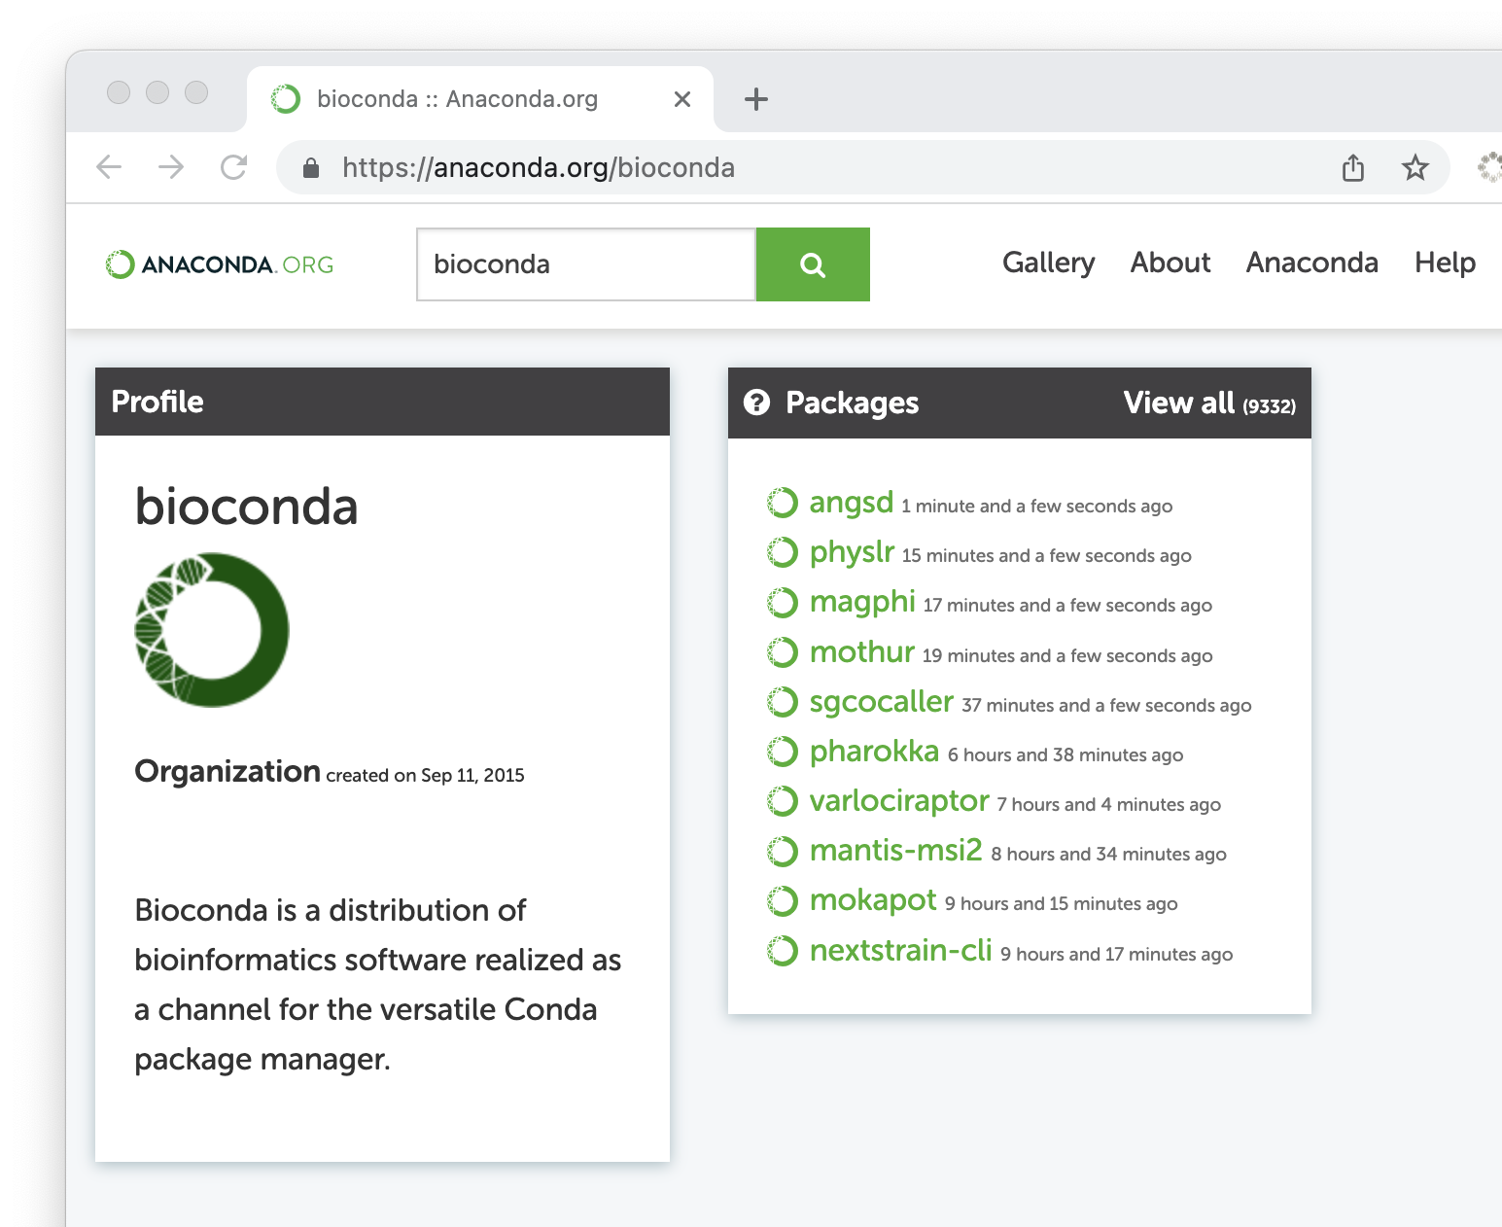
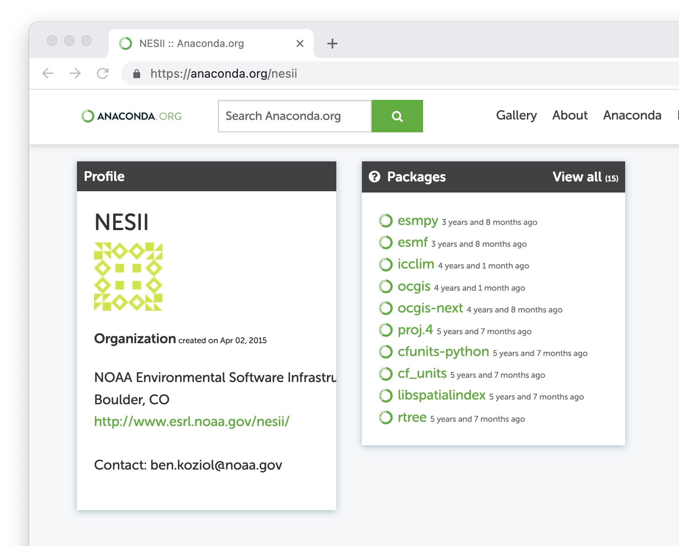

Slide 16
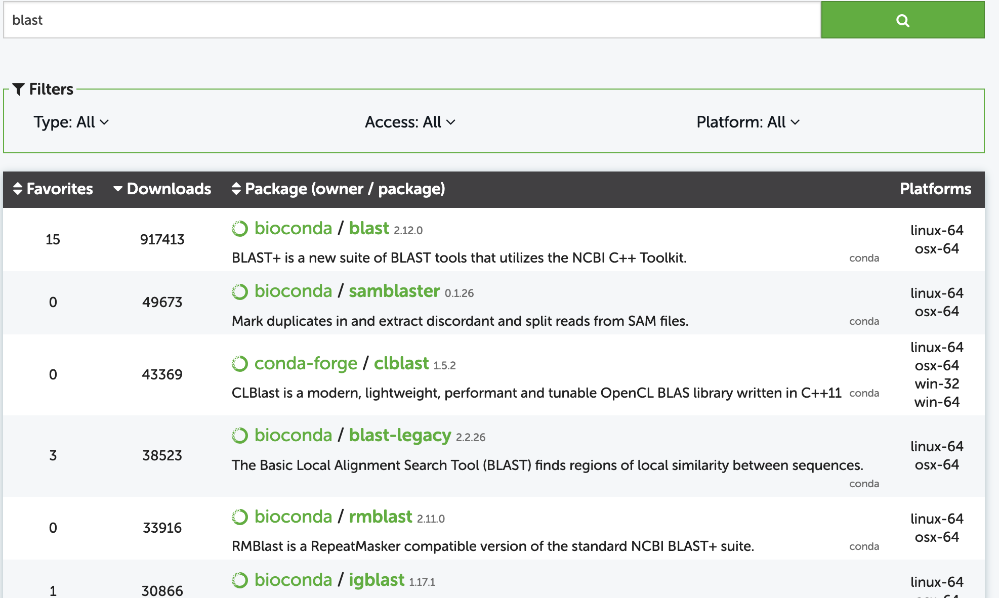

Slide 17
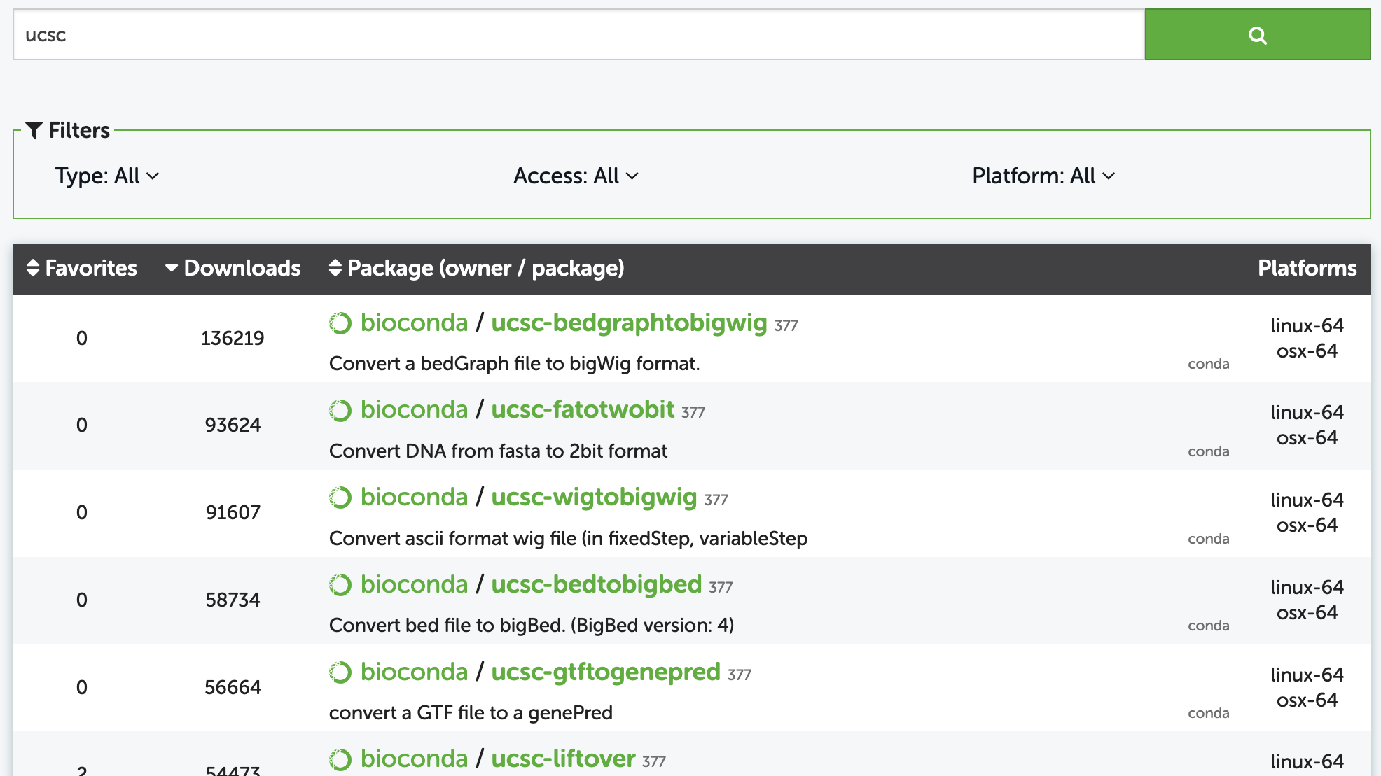

Slide 18
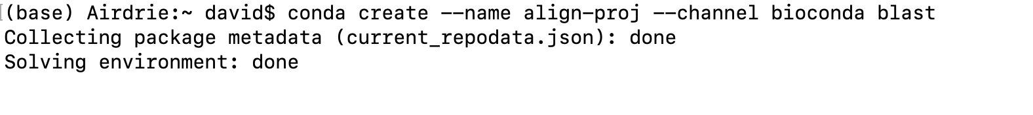
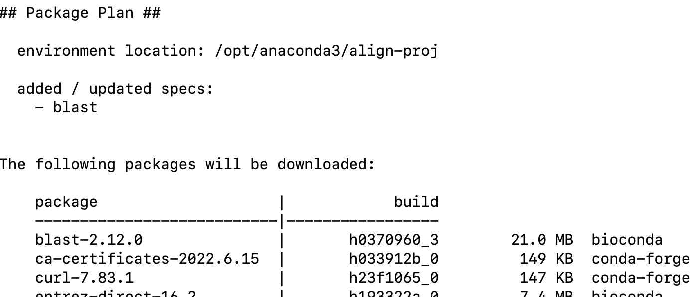
Example: make a project that uses blast

Slide 19
Activate your environment
(base) Airdrie:~ david$ conda activate align-proj
(align-proj) Airdrie:~ david$
See if blast is there
(align-proj) Airdrie:~ david$ blastn
BLAST query/options error: Either a BLAST database or subject sequence(s) must be specified
Please refer to the BLAST+ user manual.
De-activating
(align-proj) Airdrie:~ david$ conda deactivate
(base) Airdrie:~ david$ blastn
-bash: blastn: command not found

Slide 20
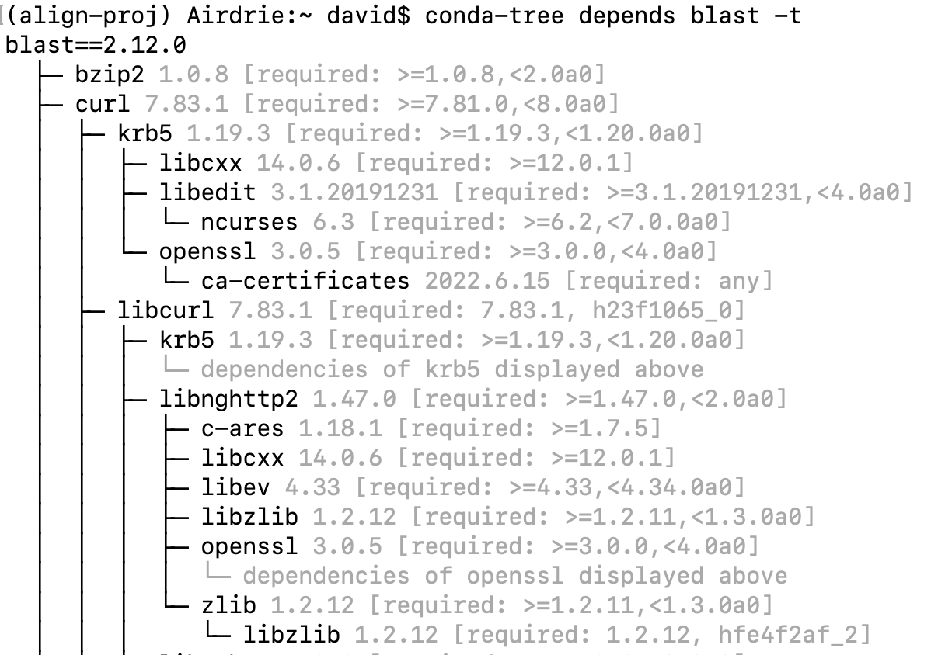
Exploring the dependancy graph with conda-tree
What does blast depend on?

Slide 21
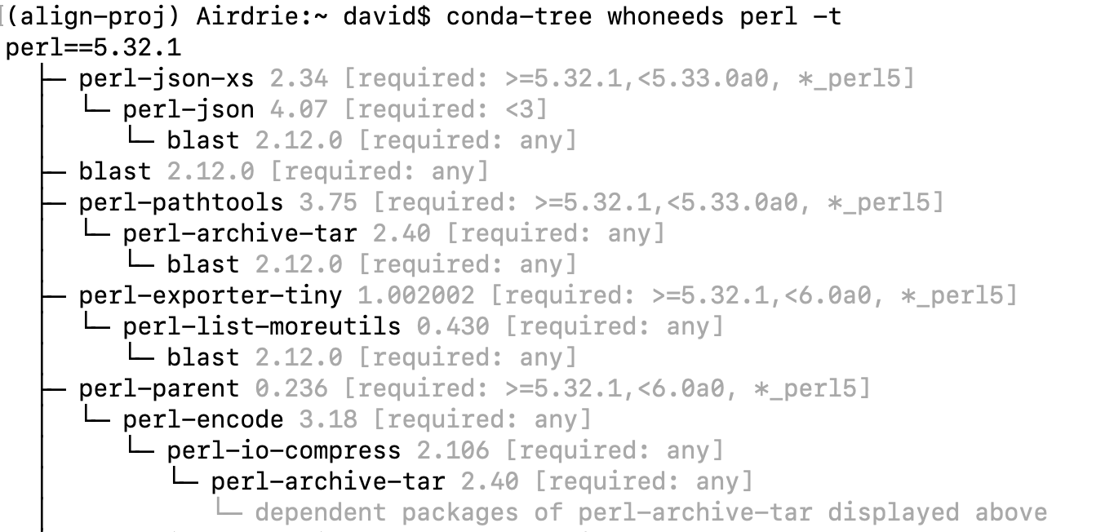
Exploring the dependancy graph with conda-tree
What depends on perl?

Slide 22
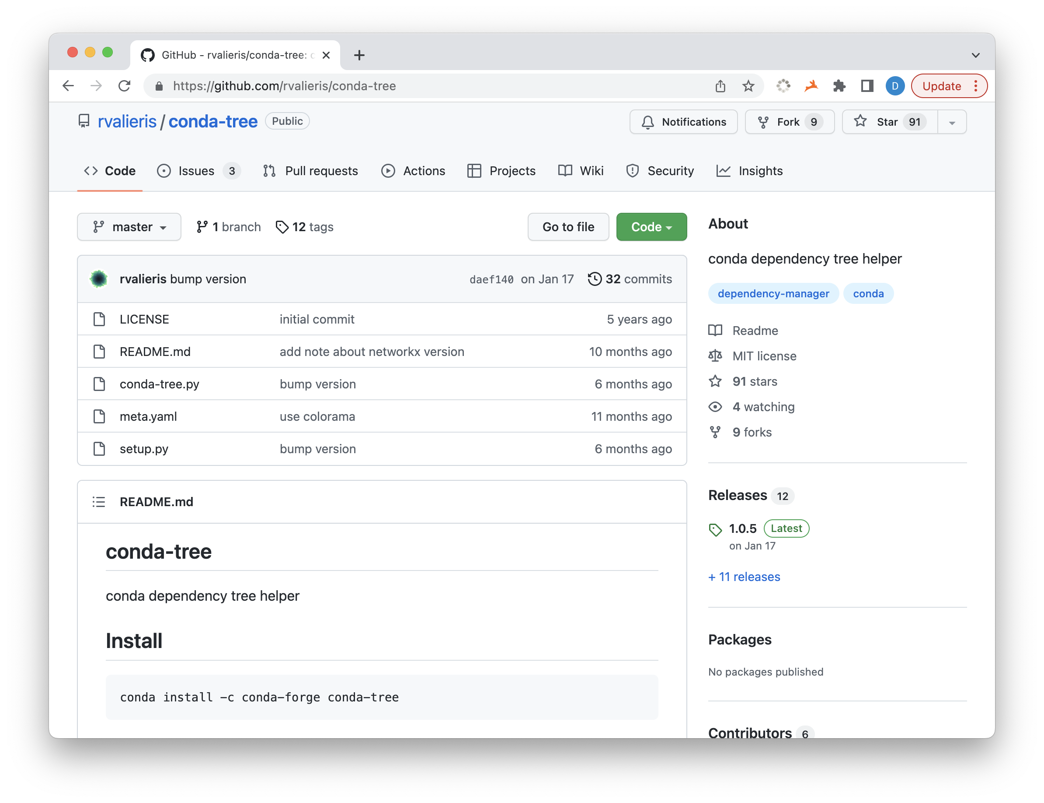

Slide 23
How to keep "base" programs visible
Put general tools in your base environment:
dos2unix – also installs mac2unix, unix2dos
tree – list directory structure in a tree-like graph
conda-tree – view dependencies
Activate new environment while retaining general tools
Add --stack to conda activate:
(base) Airdrie:~ david$ conda activate --stack align-proj
Then you can still run conda-tree, dos2unix, etc.

Slide 24
General tips
Keep environments from getting too big
Solving the dependency graph is NP-complete (scales poorly with size)
Delete downloaded source with conda clean (the installed code remains)
The conda environments accumulate a lot of files that don't need to be backed up

